Slide 1


JOYFUL BIBLE INSTITUTE
Sunday
03.15.2020

Slide 2



JOYFUL AG CHURCH OF DAVAO
Cabaguio Avenue, Agdao,
Davao City Philippines
/joyfulAGChurch
http://tiny.cc/JoyfulAG

Slide 3
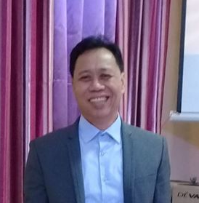
Rev. George B. GERONIMO HOST PASTOR
JOYFUL AG CHURCH OF DAVAO
Cabaguio Avenue, Agdao,
Davao City Philippines
/joyfulAGChurch
http://tiny.cc/JoyfulAG

Slide 4
Hebrews 10:25 (Let us) not giving up meeting together, as some are in the habit of doing, but encouraging one another—and all the more as you see the Day approaching.
JOYFUL AG CHURCH OF DAVAO
Cabaguio Avenue, Agdao,
Davao City Philippines
/joyfulAGChurch
http://tiny.cc/JoyfulAG

Slide 5
ROMANS 13:1 Let everyone be subject to the governing authorities, for there is no authority except that which God has established. The authorities that exist have been established by God.
JOYFUL AG CHURCH OF DAVAO
Cabaguio Avenue, Agdao,
Davao City Philippines
/joyfulAGChurch
http://tiny.cc/JoyfulAG

Slide 6
Proverbs 3:5-6 Trust in the LORD with all your heart and lean not on your own understanding; in all your ways submit to him, and he will make your paths straight.
JOYFUL AG CHURCH OF DAVAO
Cabaguio Avenue, Agdao,
Davao City Philippines
/joyfulAGChurch
http://tiny.cc/JoyfulAG

Slide 7
Proverbs 3:5-6 Trust in the LORD with all your heart and lean not on your own understanding; in all your ways submit to him, and he will make your paths straight.
JOYFUL AG CHURCH OF DAVAO
Cabaguio Avenue, Agdao,
Davao City Philippines
/joyfulAGChurch
http://tiny.cc/JoyfulAG

Slide 8
Weekend services are suspended join our online gatherings SUNDAY|9:00 AM
JOYFUL AG CHURCH OF DAVAO
Cabaguio Avenue, Agdao,
Davao City Philippines
/joyfulAGChurch
http://tiny.cc/JoyfulAG

Slide 9
JOYFUL AG CHURCH OF DAVAO
Cabaguio Avenue, Agdao,
Davao City Philippines
/joyfulAGChurch
http://tiny.cc/JoyfulAG

Slide 10
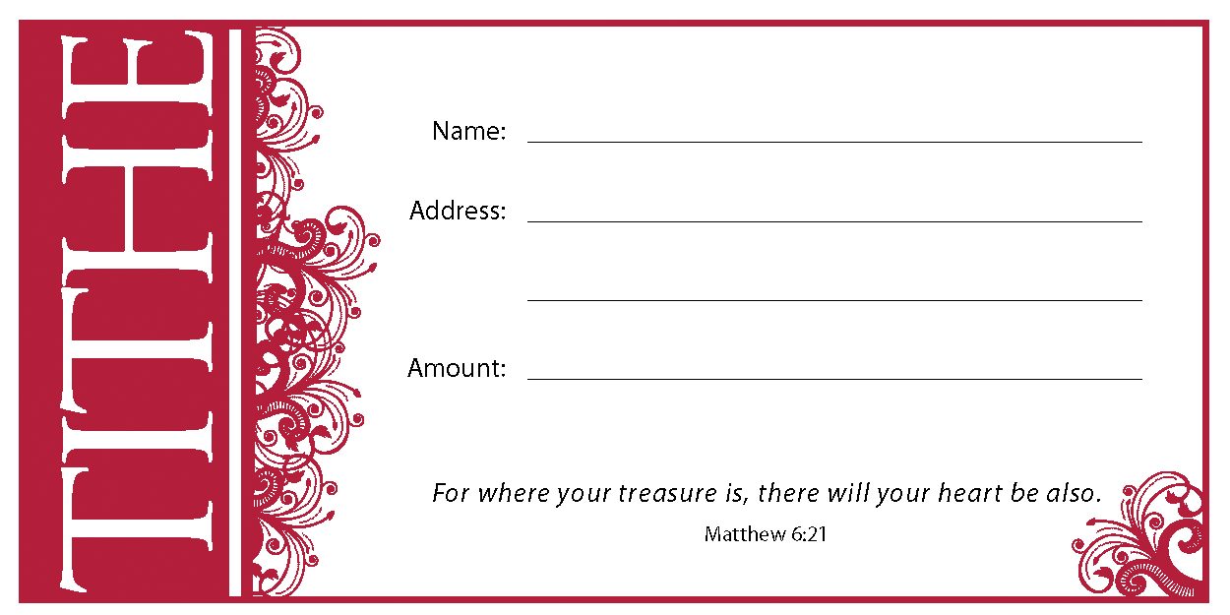
JOYFUL AG CHURCH OF DAVAO
Cabaguio Avenue, Agdao,
Davao City Philippines
1. Using your Envelope
/joyfulAGChurch
http://tiny.cc/JoyfulAG

Slide 11
JOYFUL AG CHURCH OF DAVAO
Cabaguio Avenue, Agdao,
Davao City Philippines
2. Online Bank Fund Transfer
Bank Name:
PNB
Account Name:
Joyful AG Church of Davao, Inc.
Account Number (SA):
(PHP) 400910037828
(USD) 400960037845
/joyfulAGChurch
http://tiny.cc/JoyfulAG

Slide 12

JOYFUL AG CHURCH OF DAVAO
Cabaguio Avenue, Agdao,
Davao City Philippines
2. Keep aside your giving
/joyfulAGChurch
http://tiny.cc/JoyfulAG

Slide 13

PRAYER POINTS
pray for our nation, government officials from national to local, men in uniform, medical professionals and our brethren abroad working to fight against the pandemic COVID-19
/joyfulAGChurch
http://tiny.cc/JoyfulAG

Slide 14
announcements
JOYFUL AG CHURCH OF DAVAO
Cabaguio Avenue, Agdao,
Davao City Philippines
/joyfulAGChurch
http://tiny.cc/JoyfulAG

Slide 15


March 16 – Winnie Saliling, ROSE MUÑoZ 18 – alfredo bagas 21 – Donnavie Gene Geronimo 25 – rosemarie sahagun 26 – Danielle Angela Luna 28 – arianne Leopoldo 30 – henjie rapal Ketchie Faith Coquilla

Slide 16


Slide 17
Weekend services are suspended join our online gatherings SUNDAY|9:00 AM
JOYFUL AG CHURCH OF DAVAO
Cabaguio Avenue, Agdao,
Davao City Philippines
/joyfulAGChurch
http://tiny.cc/JoyfulAG

Slide 18
PRAYER POINTS
pray for our nation, government officials from national to local, men in uniform, medical professionals and our brethren abroad working to fight against the pandemic COVID-19

Slide 19

Welcome to joyful ag church
Nicole Diosanta
Jameson L. Pasague
See you again next Sunday! ;-)

Slide 20
SCHEDULE OF SERVICES
Sunday School by Department
8:00 – 9:00 AM
Morning Service
9:00 – 11:00 AM
Children Church
10:00 – 11:00 AM
Evening Service
5:00 – 7:00 PM

Slide 21


Slide 22


Slide 23
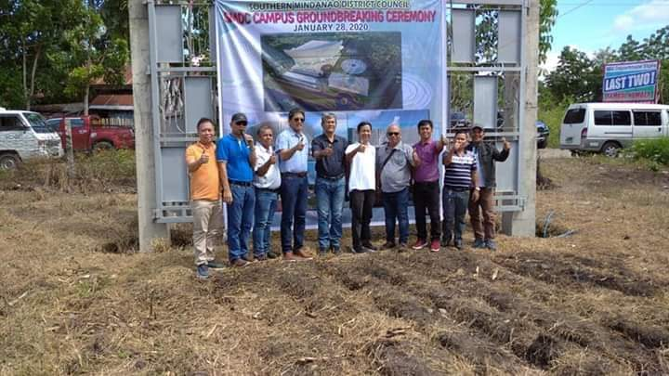
SMDC CAMPUS GROUND BREAKING (January 28, 2020)

Slide 24


Slide 25
BOARD MEETING
You are hereby directed to attend the meeting
right after the service.
For strict compliance.
Thank you!

Slide 26
Reminders: No Discipleship Training later, will resume until further notice.

Slide 27
Reminders: No Discipleship Training later, will resume until further notice.

Slide 28
Women’s Department
Please stay after the service for a short meeting.
Reminder: Fellowship @ Grace Assembly of God Church in Ma-a on March 14, 2020
Thank you!

Slide 29
Youth Department
Officers and Representatives’ Meeting, later @ 2PM. As directed by the President.
For your compliance.
Thank you!

Slide 30

Bri
Bring your own baon (b.y.o.b)

Slide 31
March 1 – mariano jr. pardo 3 – Alicia arendain 4 - James Philip Biong 4 – Ma. Maica Biong 9 – dexter dorlones 9 – ritchel lucero 12 – Ramil Morgado 14 - Frecille Ann Sagusara 15 – eric lucero *today 16 – Winnie Saliling, ROSE MUÑoZ 18 – alfredo bagas 21 – Donnavie Gene Geronimo 25 – rosemarie sahagun 26 – Danielle Angela Luna 28 – arianne Leopoldo 30 – henjie rapal

Slide 32
February 8 – Joseph Tapiamon 9 – phil gerodias 10 – Ely Bustamante 13 – Vanessa Enot 13 – virginia ballaret 13 – Andy Abanto 14 – bella geronimo 15 – guellermo “jun” lagumbay 16 – Jance abanto 22 – Jussel Moral 27 – lecel reyes

Slide 33
Belated happy birthday 27 – lecel S. reyes

Slide 34
happy birthday 16 – Jance abanto

Slide 35
DISCIPLESHIP TRAINING MATERIAL
BOOK: “PATUKURANAN SA PAGTOO” (FOUNDATION)
Pre-order for only
Price: PHP 320.00
Price: PHP 280.00

Slide 36
Special board meeting
To all board members, please be back later at 3PM for the special board meeting.
For your compliance.
Thank you!

Slide 37
Culmination of prayer and fasting
Join the culmination night here in our church this coming Friday, Jan. 24, 2020, 7PM-10PM.
“In my distress, I called to the Lord, and He answered me.” Psalm 120:1
Thank you!

Slide 38
JANUARY 04 – Princess keith segura 05 – jaiah mer ubas 05 – jovelyn segura 05 – elizabeth mongcal 06 – rey daquipil 07 - Bernadette Grace DAQUIPIL 16 - andy abanto 16 - roger sevillano 18 – Charmaine P. Geronimo 23 - AZIEL LAYSON 24 – vevon dorlones 25 – Jemar Limuran 26 – noel reyes 26 – jeniffer bIOng

Slide 39
Praise and worship team meeting
To all board members, dept. heads (MM, WM, YA/Youth & PH569 Student Center), Pastoral Staff(s), Thanksgiving Committee Heads and Members, please be back later at 2PM for our first meeting for the
fiscal year 2020.
Complete attendance is a must.
Thank you!

Slide 40
JANUARY 26 – noel reyes 26 – jeniffer bIOng

Slide 41
Welcome to joyful ag church
Josie M. Adorable
Ruel M. Manlubatan
Marites M. Manlubatan
See you again next Sunday! ;-)

Slide 42
Belated Happy birthday December 2019 06 – Arbe Boy saluntay 06 – Julius ceazar cacas 06 – jerelyn luna 10 – FAUSTINO PAGUIRIGAN 11 – JOSEPHINE BONIAO 12 – jesseryl palma 13 – ANJY ABANTO 13 – andy abanto 14 – PTRA. NARCISA GERONIMO 16 – dianna egot 19 – garry segura 22 – PTR. GEORGE GERONIMO 23 – princess joy perez 24 – rogel Alonzo
28 – LEAH PARDO
31 – RAFFY SUAYO
31 – FELIMON BONIAO

Slide 43
BOARD and COUNCIL meeting
To all board members, dept. heads (MM, WM, YA/Youth & PH569 Student Center), Pastoral Staff(s), Thanksgiving Committee Heads and Members, please be back later at 2PM for our first meeting for the
fiscal year 2020.
Complete attendance is a must.
Thank you!

Slide 44
Welcome! Jacqueline D. Candazo

Slide 45
Prayer & Fasting January 04, 2020 1st SATURDAY OF THE MONTH

Slide 46
Special Offering: Earthquake Victims (Assembly of God Churches in Kidapawan and Makilala)

Slide 47
Children’s Sunday
November 24, 2019

Slide 48


Slide 49
YA-ball
Basketball game will resume tonight at 8:30PM to 10:30PM, Lifestream Gym
Thank you!

Slide 50
Men’s Ministry Department
Meeting after service

Slide 51
WM
Please stay after the service for a meeting.
Thank you!

Slide 52

Palos Verdes Sports and Country Club Inc.
Maa Diversion Road, Davao City

Slide 53


Slide 54
november 02 – Aries Moran 03 – Carlo Miguel Solon 03 - Jairah Natania Sahagun 05 - Jiannah Natalie Villanueva 05 – Rosalie Clarito 06 – Leslie Paguirigan 06 – Emma Rejas 07 - Salve B. Espadera 09- Szchedrieck Raganit 10 – Daniel Francis Munoz 10 – Xiara Franceska Munoz
11 - Neresa Mahilum
13 - Selah Quinley Labanero
19 – Ptr. Nina Cagumbay
22 – Joycee Gomez
23 – Lera Ann Pansaon
24 – Mariz Jean Moran
24 – Michelle Lagungan
25 - Ailyn Raganit
26 - Regem M. Ruado
26 - Meljoy M. Anke
27 - Lemuel Lyson
29 – Shella Garaydo
29 – Kristine Jean Boniao
29 – Ricardo Ellacer

Slide 55
Belated happy birthday October 14 – Regine G. Cacas 15 – Junbert Sahagun 16 – Ptr. Vhonex Elbanbuena

Slide 56
Pastors’ Appreciation Sunday September 29, 2019
When was the last time you let your pastor and his/her family know that you appreciate them?
SHOW SOME LOVE. BE A BLESSING.

Slide 57
7 Things to remember when you are in trouble:
Never Stop Praying
God is capable to solve your problem
Think about the past miracles that God has done in your life.
He Is A Supernatural Being
His love is unconditional
Remember His Promises
He Is A Living God

Slide 58
7 Things to remember when you are in trouble:
Today is yesterday’s tomorrow

Slide 59
Welcome! Jacqueline D. Candazo

Slide 60
Thanksgiving ‘2019
December 22, 2019
Service will start at exactly 8:00AM
Formal Attire

Slide 61
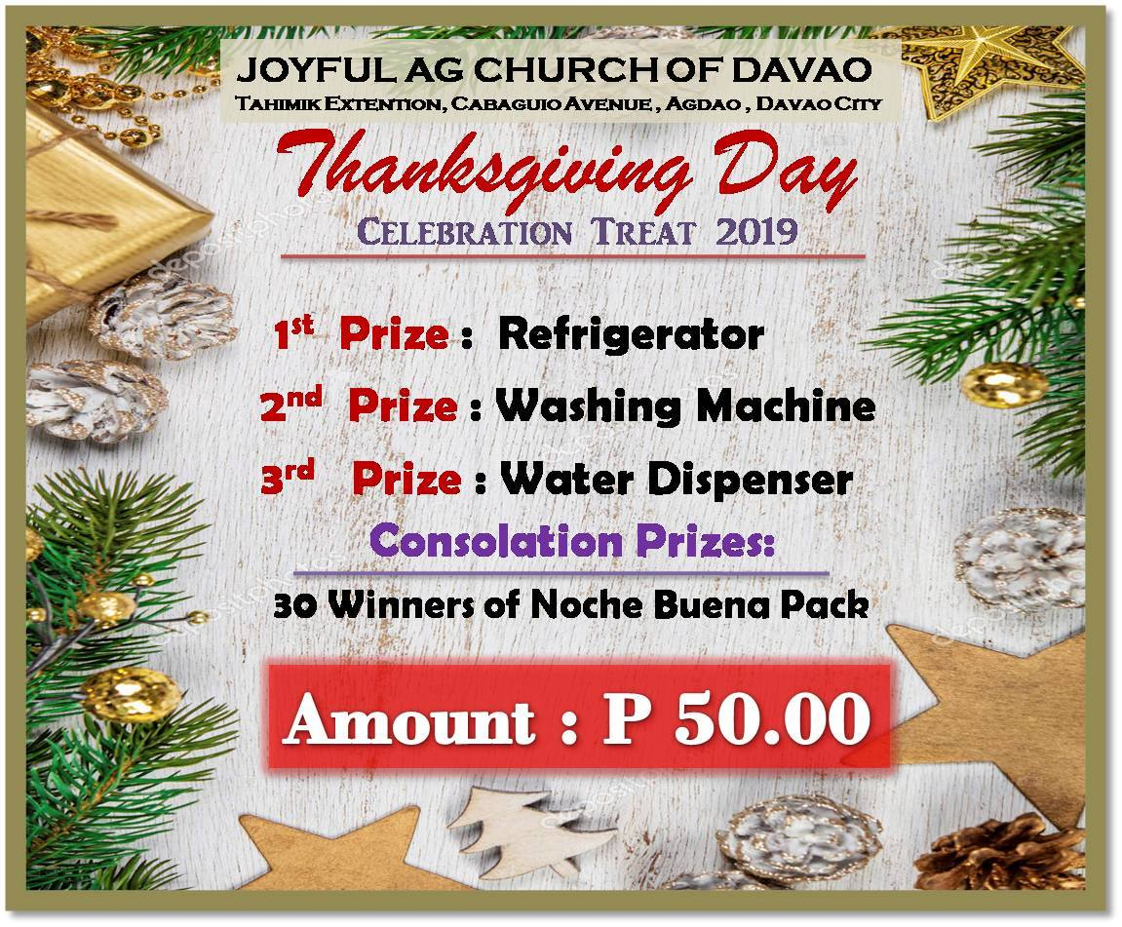

Slide 62
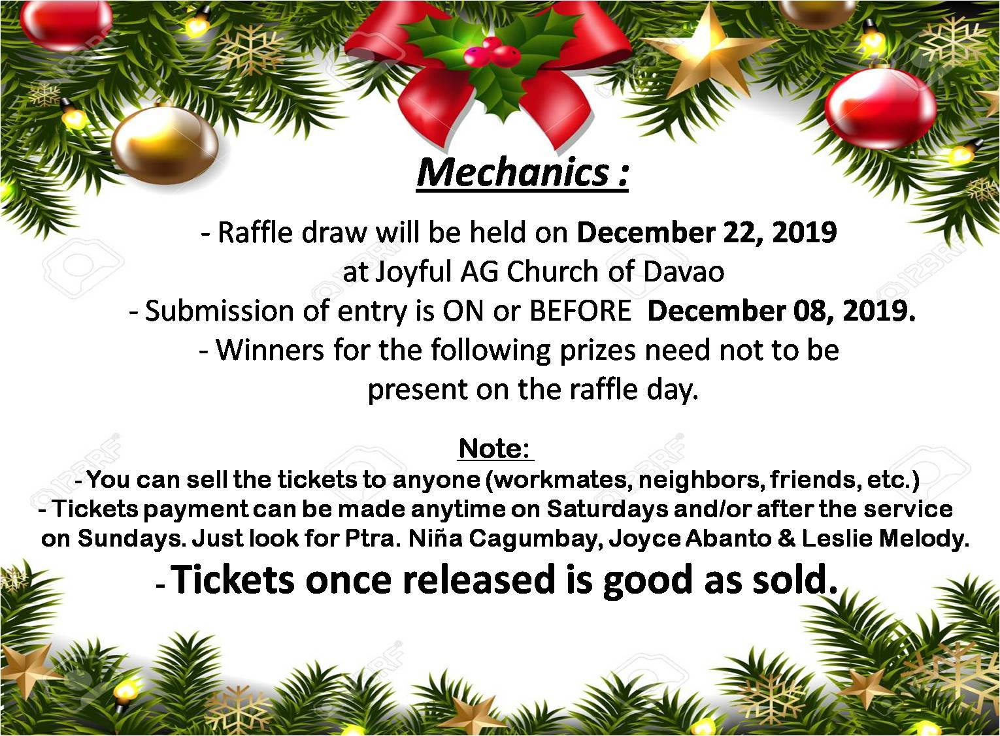

Slide 63
Prizes for the Creative Booth Competition:
1st Prize – PhP 7,000.00
2nd Prize – PhP 5,000.00
3rd Prize – PhP 3,000.00
Consolation Prizes – Surprise!

Slide 64
Criteria for judging re: Creative Booth Competition
Creativity – 40%
Relevance to the theme – 30%
Appearance and Presentation – 30%
TOTAL of 100%

